Slide 1
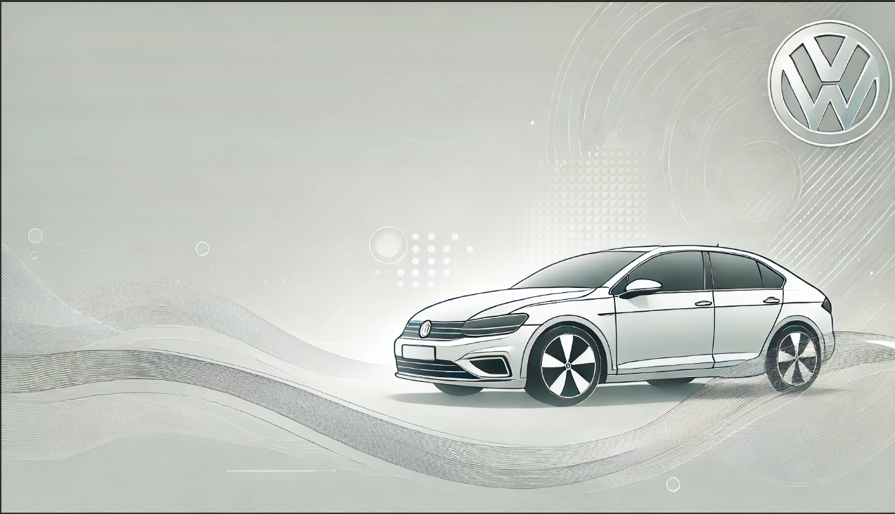
Safe and Efficient Drives

Slide 2
Problem Statement
Challenge:
Tires wear out over time, impacting safety and performance. Drivers lack tools to predict tire replacement or assess road-tire dynamics.
Impact:
Leads to accidents, reduced fuel efficiency, and suboptimal performance.
Opportunity:
Predict tire lifespan and cornering forces using machine learning and real-time image processing.

Slide 3
Proposed Solution
Tire Lifespan Prediction:
Use machine learning to analyze tire wear data (mileage, pressure, etc.) and predict replacement needs.
Force Prediction:
Analyze road edges and distance using image processing to anticipate cornering forces.
Goal:
Enhance safety, enable proactive maintenance, and improve driving performance.

Slide 4
Technical Approach
Tire Replacement Prediction:
Data Collection: Mileage, tire pressure, driving conditions.
Model Training: Using ML algorithms like regression and survival analysis.
Prediction: Remaining tire lifespan for proactive replacement.
Distance & Force Prediction:
Image Analysis: Real-time images from a 360-degree camera.
Edge Detection: Canny edge detection and Hough Lines to find road edges.
Force Estimation: Calculate forces based on detected distances.

Slide 5
Prototype Implementation
Machine Learning Model:
Built using TensorFlow/Keras.
Data augmentation to improve accuracy.
Multi-class output for tire condition predictions.
Image Processing Module:
Developed with OpenCV.
Road edges detected using Canny edge detection.
Force calculated from tire-edge distances.

Slide 6
Prototype Code Workflow
ML Pipeline:
Preprocess data with ImageDataGenerator.
Build CNN model with TensorFlow.
Train and save the model for predictions.
Image Processing Pipeline:
Load real-time images.
Detect edges and calculate distances.
Predict forces and visualize results.

Slide 7
Results
ML Model:
Accuracy: 90%+ on validation data.
Predicts tire wear and lifespan effectively.
Image Processing:
Road edge detected with high precision.

Slide 8
Benefits
Safety:
Reduces risk of accidents.
Efficiency:
Enables timely tire replacements and optimizes cornering.
Sustainability:
Prolongs tire life and reduces waste.

Slide 9
Future Scope
Real-World Testing:
Integrate the system with real-time cameras and car sensors.
Advanced Analytics:
Use deep learning for more accurate force and tire wear predictions.
Scalability:
Apply the solution to various vehicle types and road conditions.

Slide 10
DATATRENDS
FROM VITAP
Satwik Hananya Sikha
Mrudula Angel Mallavarapu
Dasarna Busi
D.VL.SATYA

Slide 11
Thank You

